Slide 2
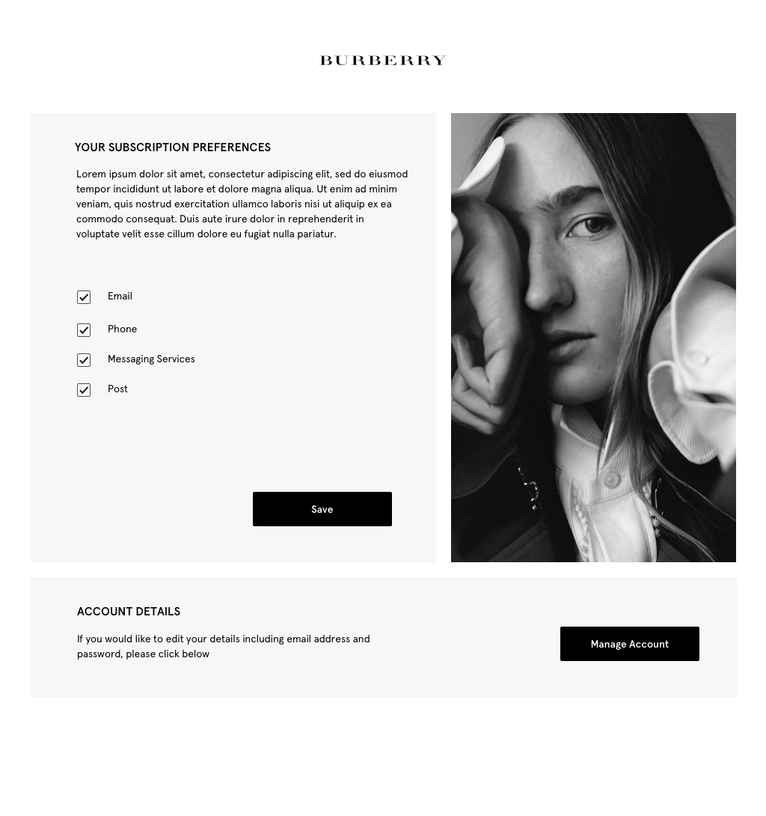
DEFAULT

Slide 3
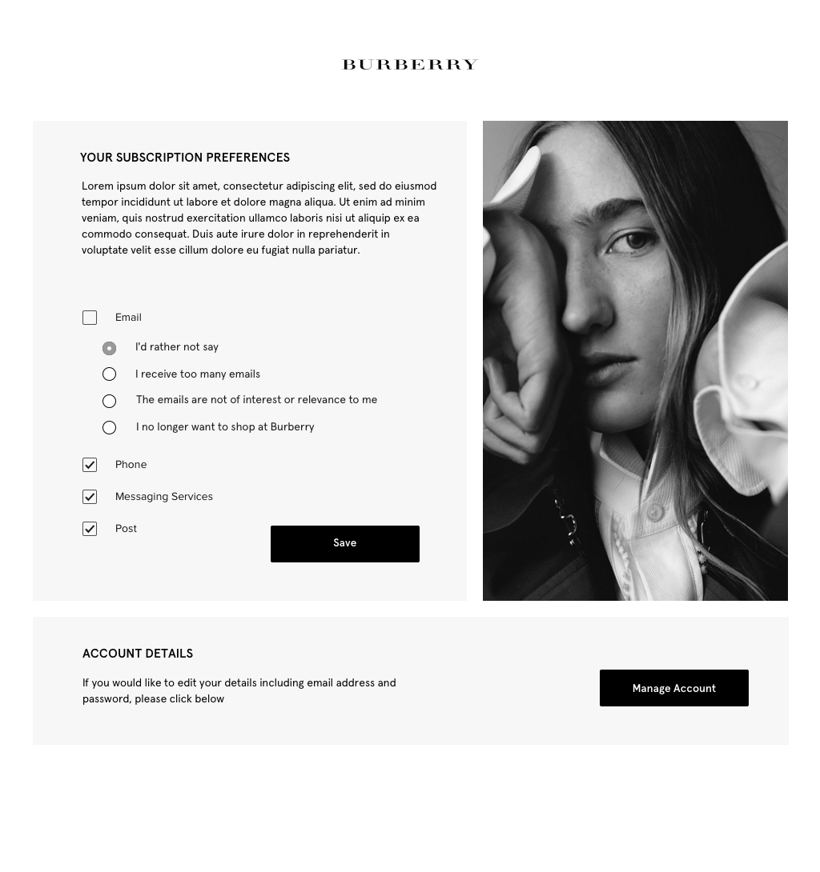
EMAIL UN-CHECKED

Slide 4
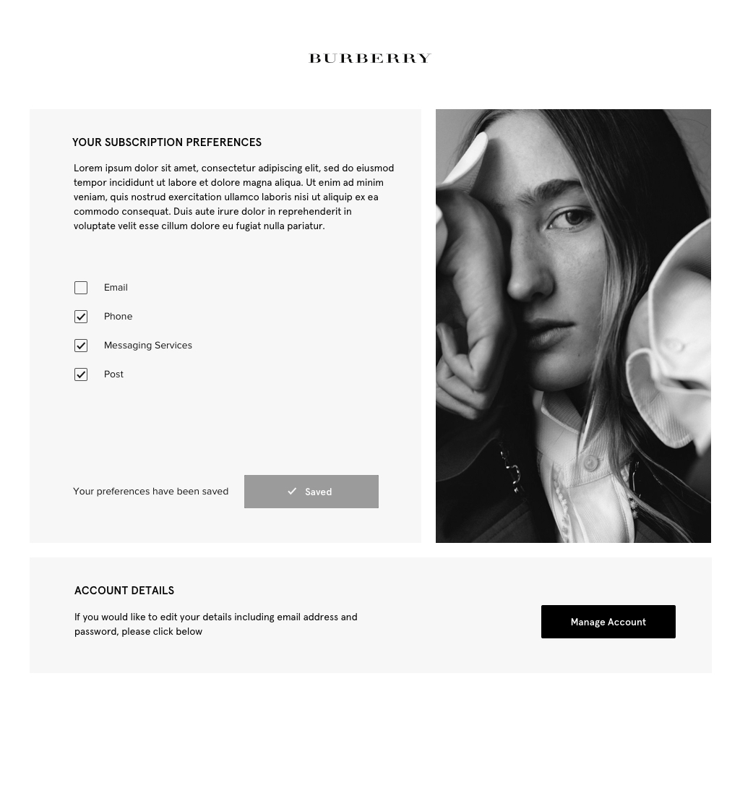
SAVED
Fade in for 0.5 seconds,
Stay for 2 seconds,
Fade out for 0.5 seconds

